Slide 1

Economics and Science for Environmental Sustainability (ESES, L-33) Luca Corazzini, DEMS - UNIMIB
Welcome to ESES! UNIMIB, September 30, 2025

Slide 2
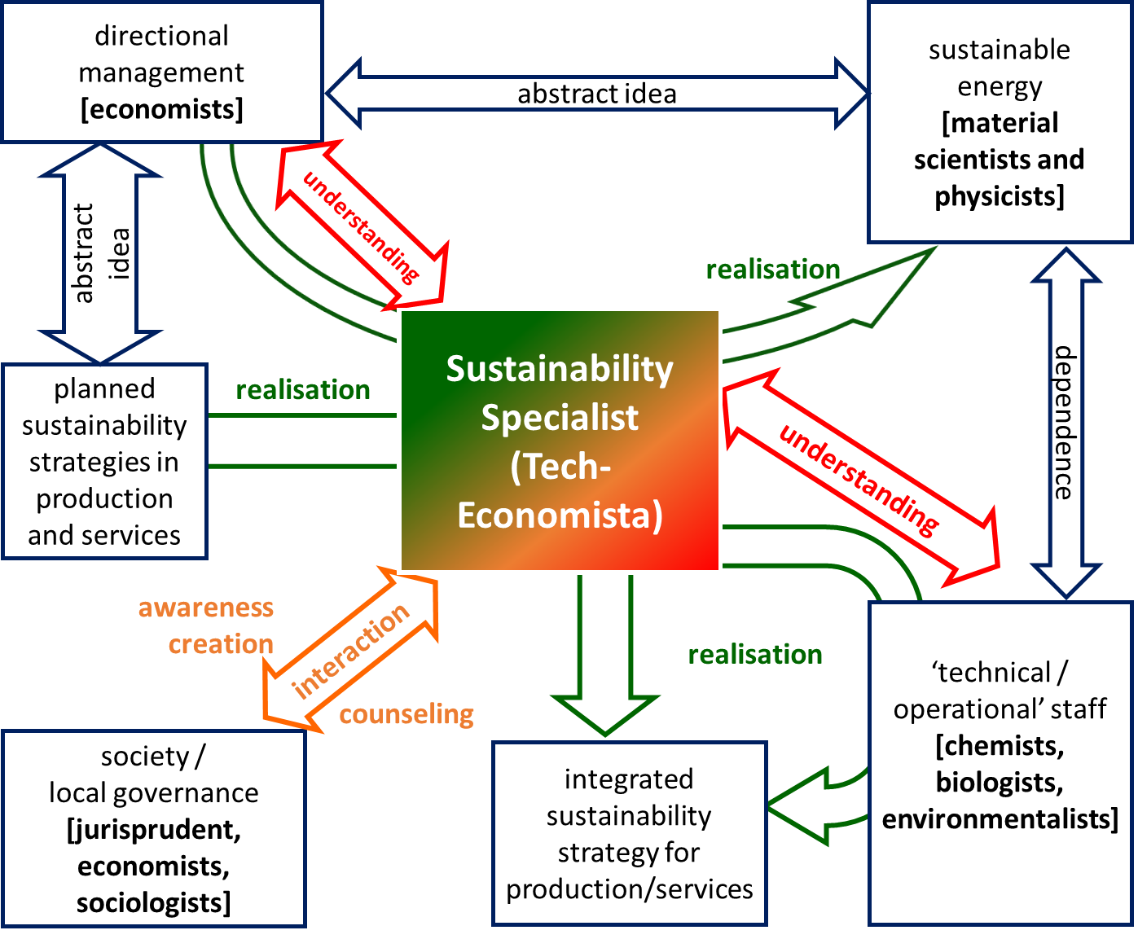
The ESES idea
The Sustainability Specialist is a tech-economist whose holistic perspective on the interaction between economic and environmental systems supports the institutions where they work professionally in adopting new, profitable, and sustainable managerial approaches
Welcome to ESES! UNIMIB, September 30, 2025

Slide 3
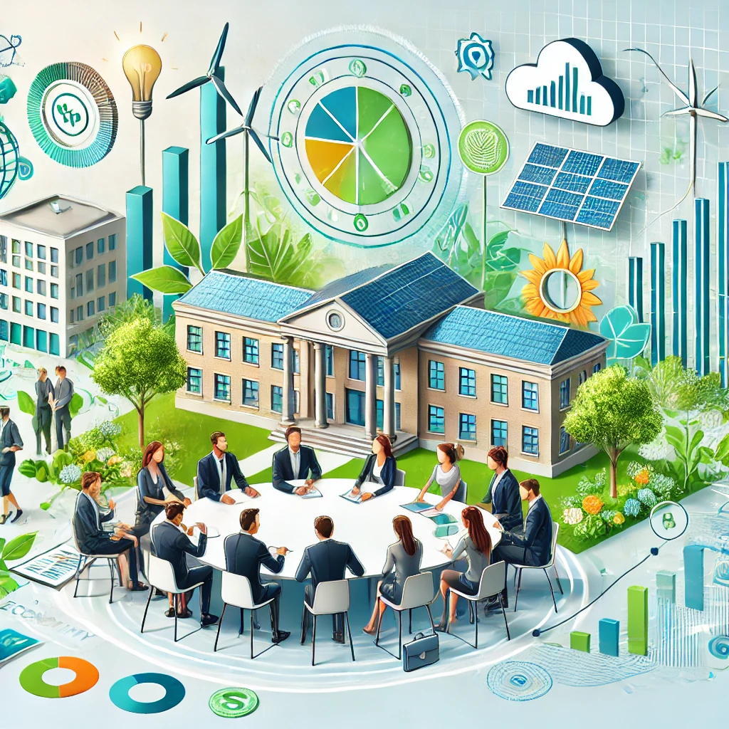
Skills and professional profile of the ESES student
The ESES student:
Possesses the economic and scientific skills necessary to interpret the characteristics and dynamics of economic systems and markets, with a particular focus on environmental sustainability and the sustainable management of both natural resources and energy sources;
Identifies managerial and technological solutions to optimize productive processes, input productivity, logistics, and economic costs from both economic and environmental perspectives;
Is proficient in implementing empirical, statistical, and computational methodologies to collect, manage, and analyze large datasets
Welcome to ESES! UNIMIB, September 30, 2025

Slide 4
Skills and professional profile of the ESES student
After graduation, the ESES student:
Engages in highly qualified professional roles within productive and service firms, public administrations, consultancy companies, international institutions, research centers, and other professional entities leading the ecological transition and promoting sustainable and circular economic models;
Pursues further studies in a Master’s program in economics and management, such as the newly established LM-76 «Economics and Technologies for Sustainability» at UNIMIB
Welcome to ESES! UNIMIB, September 30, 2025

Slide 5
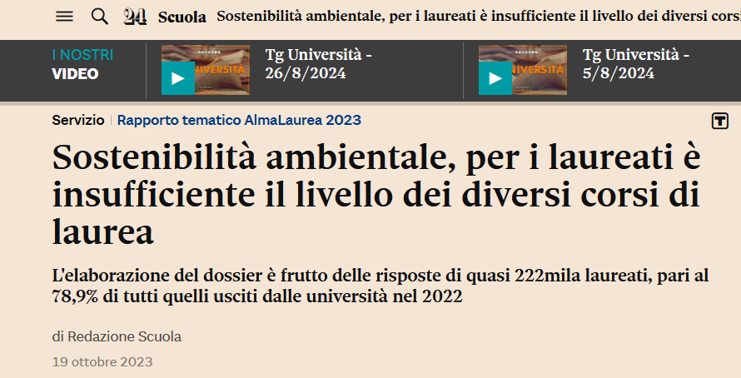
Why the new BA in “Economics and Science for Environmental Sustainability”?
1. UNIMIB Strategic Plan 2023-2025: “New teaching proposals will align with the strategic choices of both the Nation and the University, following the guidelines of sustainability, transdisciplinarity, and internationalization”
2. Addressing Educational Gaps: The current academic offerings are insufficient to meet the growing demand for BA programs that focus on the interaction between economic systems and environmental sustainability
Welcome to ESES! UNIMIB, September 30, 2025

Slide 6
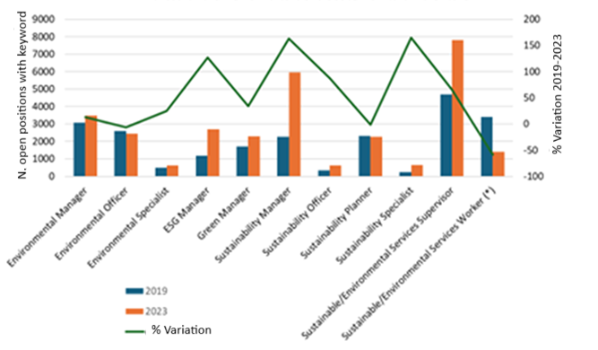
Why the new BA in “Economics and Science for Environmental Sustainability”?
3. A Highly Sought-After Professional Profile: The program responds to the increasing need for professionals skilled in both economic and environmental sustainability, aligning with emerging job market trends
Note: Results of an analysis of the job market concerning new positions in the field of environmental sustainability. (*) Number of position x10. Source: Eurostat/Cedefop, project SkillOvate (https://www.cedefop.europa.eu/en/tools/skills-online-vacancies).
Welcome to ESES! UNIMIB, September 30, 2025
Notes:
Sustainability Specialist/Manager: ESG, economia circolare, Life-Cycle Assessment, energia rinnovabili, riciclaggio, finanza sostenibile.
Centro di Ricerca Interuniversitario per i Servizi di Pubblica utilità (CRISP)

Slide 7
ESES at a glance
BA classification (Italian system): L-33 ECONOMIC SCIENCES;
Teaching language: English (>B2 language certificate required);
Number of students: 150 selected through the CenT (Test Cisia) in English; Minimum score 28 in Mathematics and Reasoning, and 15.5 in Mathematics;
University credits: 180 UC, with approximately 30% of activities delivered through e-tivities
Duration: 3 years
Location: University of Milan – Bicocca
Affiliated Departments: Department of Economics, Management, and Statistics (DEMS), with strong collaboration from the Department of Earth and Environmental Sciences (DISAT)
First academic year: 2025-2026
Welcome to ESES! UNIMIB, September 30, 2025

Slide 8
The teaching approach: key features
Inter- and transdisciplinary approach: combining economics with fundamental knowledge in biology, chemestry, geology;
Case-based learning: lectures delivered collaboratively and in co-presence by professors from different academic disciplines;
Data-Driven Analysis: application of modern computational and statistical methods to manage and analyze large-scale economic and environmental datasets;
Innovative Learning Methods:
Team projects and flipped classrooms to encourage interactive and critical thinking;
Seminars and debates with scientists and industry leaders in environmental sustainability;
E-tivities to foster independent learning and self-assessment
Industry & Academic Partnerships:
Collaboration with leading firms and institutions in environmental sustainability;
Strong international network (including Erasmus and the European Alliance INVEST)
Welcome to ESES! UNIMIB, September 30, 2025

Slide 9
Minimum requirements for a BA in economics and the ESES project
In the Italian system, a BA in economics must include at least 90 UC (out of 180) in the following disciplinary areas:
40 UC in Economics
15 UC in Management
20 UC in Mathematics and Statistics
15 UC in Law
ESES fulfills the standard disciplinary requirements while integrating 30 UC in Biology, Chemistry, and Geology, ensuring a multidisciplinary approach:
45 UC in Economics
30 UC in Management
33 UC in Mathematics and Statistics
15 UC in Law
30 UC in Biology, Chemestry, and Geology
Welcome to ESES! UNIMIB, September 30, 2025

Slide 10
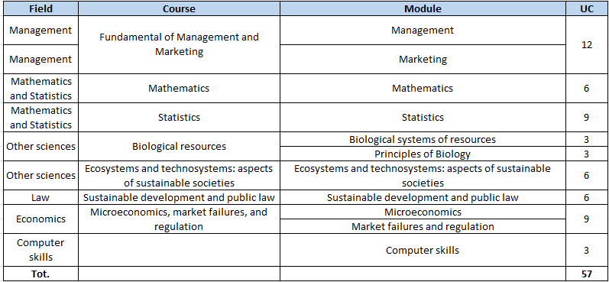
Teaching plan: first year
Welcome to ESES! UNIMIB, September 30, 2025

Slide 11
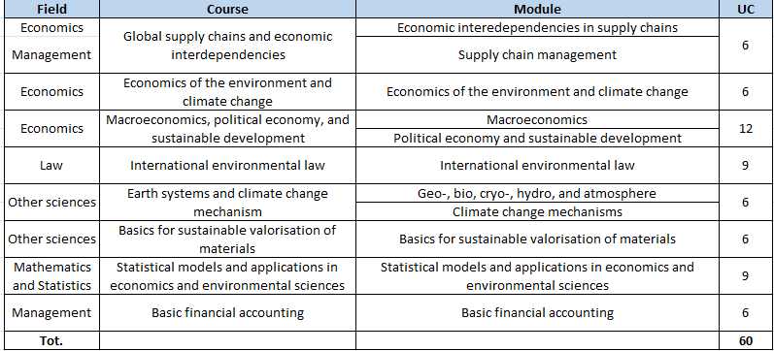
Teaching plan: second year
Welcome to ESES! UNIMIB, September 30, 2025

Slide 12
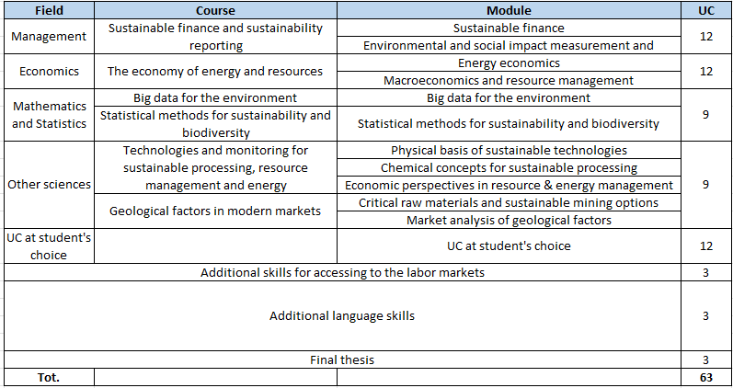
Teaching plan: third year
Welcome to ESES! UNIMIB, September 30, 2025

Slide 13
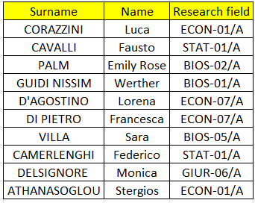
Coordinating faculty
The Department of Economics, Management, and Statistics (DEMS) joins forces with the Department of Earth and Environmental Sciences (DISAT) to deliver a truly interdisciplinary program. Both departments have been recognized as “Departments of Excellence 2023–2027”, reinforcing their commitment to high-quality research and innovative education
Welcome to ESES! UNIMIB, September 30, 2025

Slide 14
Professional actors involved in the ESES project
The following professionals, representing their respective institutions, participated in the ESES coordinating meetings held on June 24, 26, and July 1, 2024:
Dr. Monica Riva, Sustainability Product Line Manager, Bureau Veritas Italy;
Dr. Marco Antonio Cataldi, Circular Economy Manager, Bureau Veritas Italy;
Dr. Deborah Serino, HR Business Partner GEM, Research & Development, Sorgenia;
Dr. Lisa Sorbi, Compliance & Privacy Manager, Sorgenia;
Dr. Salvatore Balsama, Professional Industrial Chemist, Secretary of the Lombardy Chemistry Association;
Dr. Luca Raffaele, General Director, NeXt - Nuova Economia per Tutti;
Dr. Marta Camilla Valota, Director, ISCOS Lombardy;
Dr. Veronica Cremonesi, Education & Professional training, Federchimica;
Dr. Monica Garbarino, Regulatory & Public Affairs Manager, Agrofarma
This diverse group of experts ensures that ESES is aligned with industry needs, fostering a strong connection between academia and professional practice
Welcome to ESES! UNIMIB, September 30, 2025

Slide 15
Grazie!
ESES (L-33): Luca Corazzini (luca.corazzini@unimib.it)
Welcome to ESES! UNIMIB, September 30, 2025

